Slide 1
Grand Stem Challenge 2023 Website Developement
CLB WEB 1

Slide 2
Table of contents
01
02
03
04
05
Team and task division
HTML,CSS, and Javascript
06
Concept and Purpose
Library and Framework
07
Chanllenge Solving
Project’s Key Feature
08
Design Choices
Personal Development

Slide 3

01
Our Team
CLB WEB 1

Slide 4
Our Team
Yeoh Wan Qi
Role: Design
SUN YI NING
Role: HTML Build
LIM XING YING
Role: Database

Slide 5
02
Concept and Purpose
CLB WEB 1

Slide 6

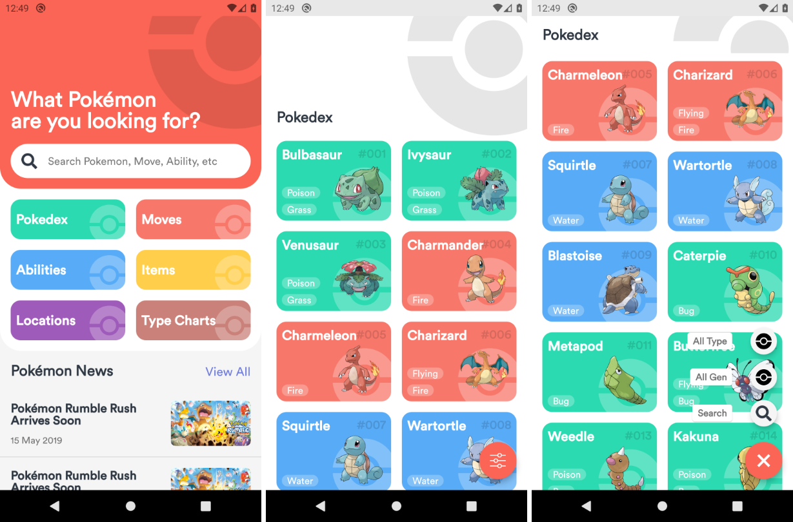
POKEDEX
To show and learn about Pokemon’s information

Slide 7
03
Project Key’s Feature
CLB WEB 1

Slide 8
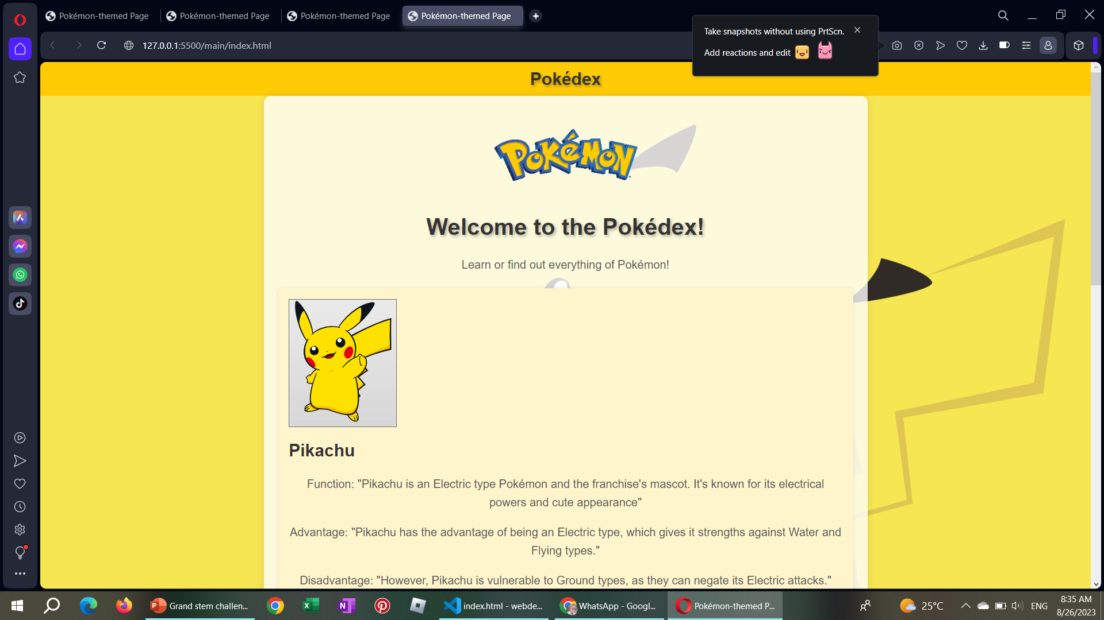
Project Key’s Feature
Comprehensive Pokémon Database: Dive into a vast and comprehensive database that houses an extensive collection of Pokémon species from various generations of the Pokémon games.
Detailed Pokémon Profiles: Each Pokémon is presented with a detailed profile that includes its name, Fuction, Advantage, Disanvantage and more. Get an in-depth understanding of the unique traits that make each Pokémon special.

Slide 9
04
Design Choices
CLB WEB 1

Slide 10
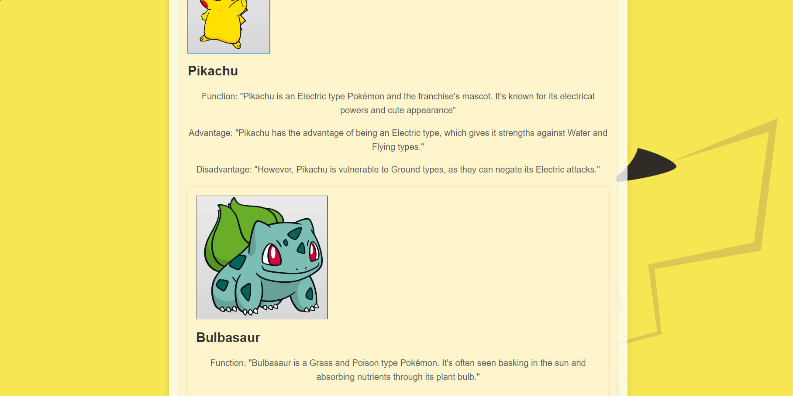
Design Choices
The color yellow is closely associated with the iconic Pikachu, one of the most recognizable and beloved Pokémon characters. The design choice of a yellow background for a Pokédex can carry specific connotations and evoke certain emotions that align with the Pokémon brand and the concept of discovery.

Slide 11
05
HTML,CSS and JAVASCRIPT
CLB WEB 1

Slide 12
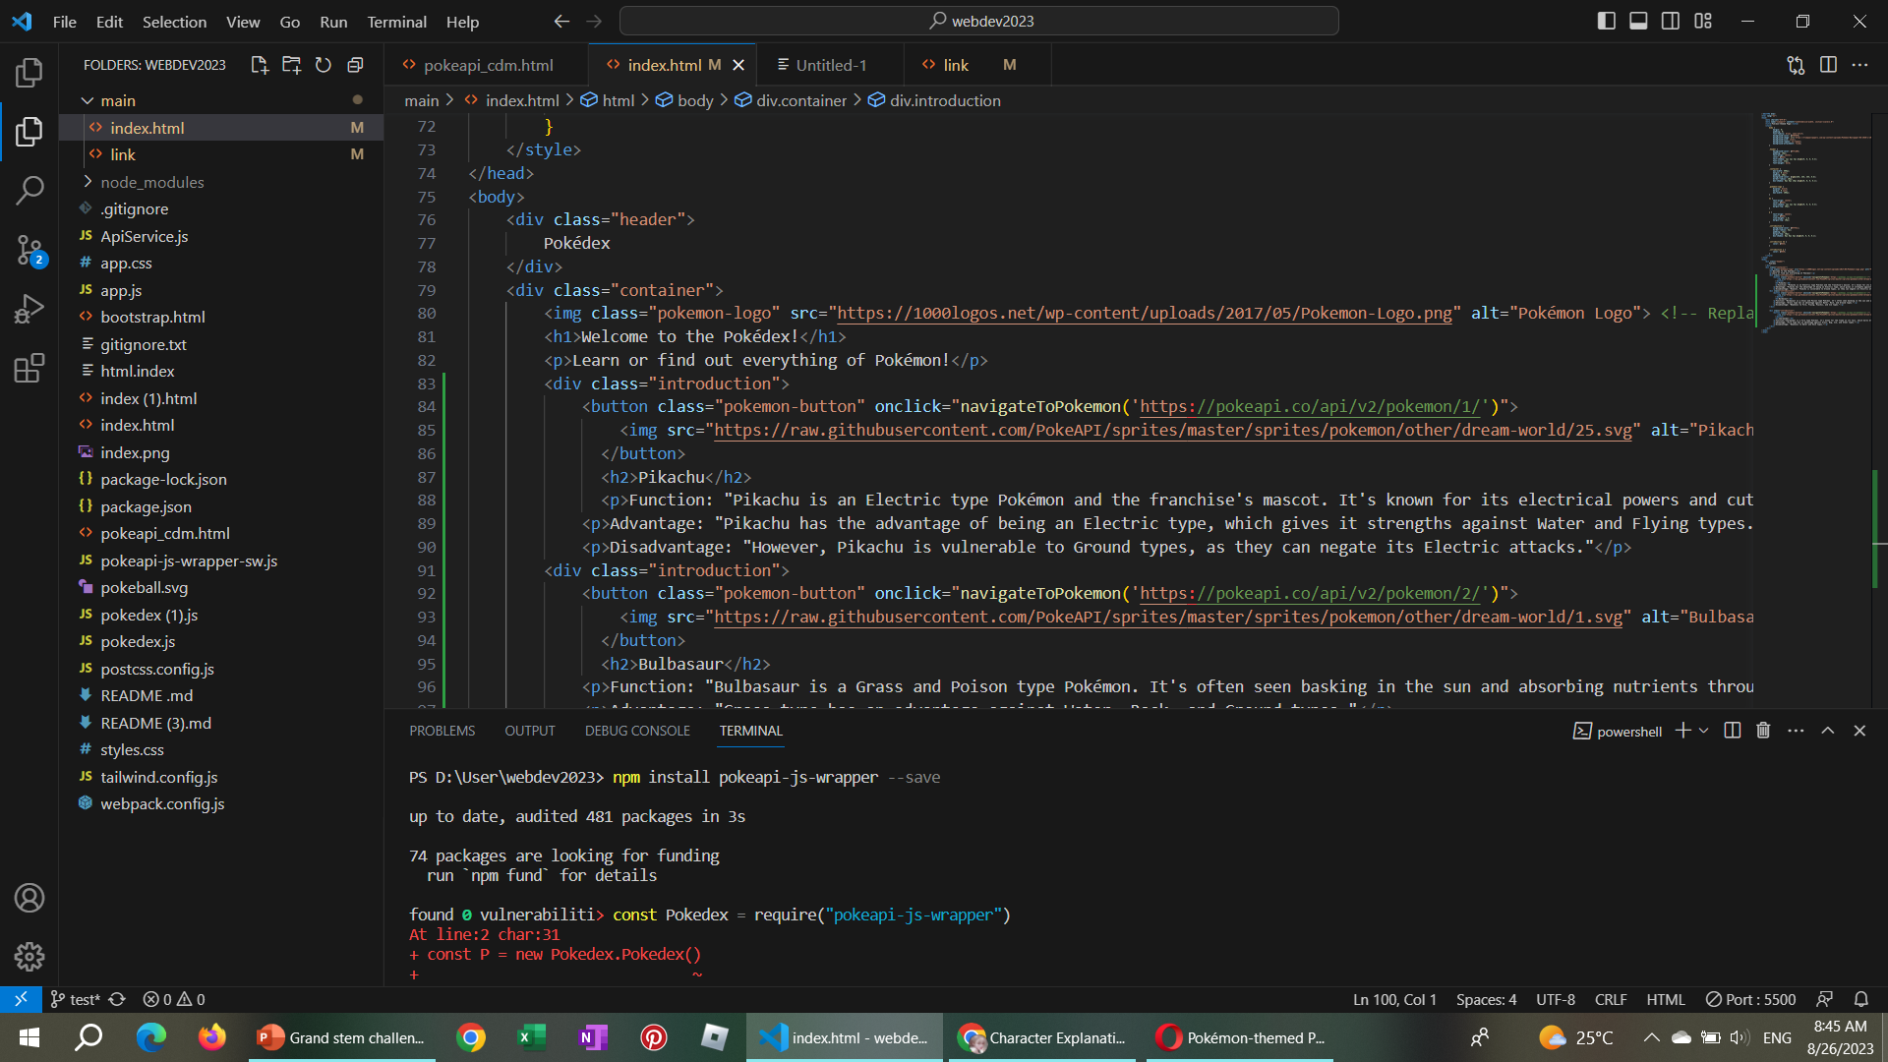

Slide 13
06
Libraries and Framework
CLB WEB 1

Slide 14

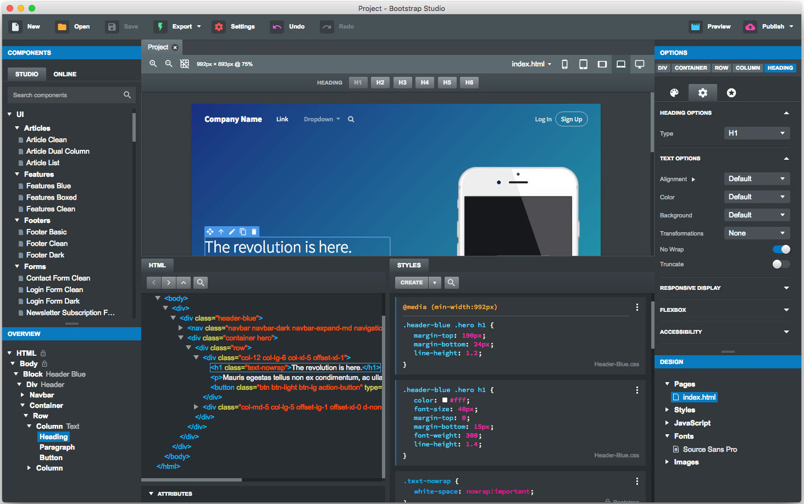


Libraries and Framework
TailwindCSS
Bootstrap

Slide 15
07
Challenge Solving
CLB WEB 1

Slide 16
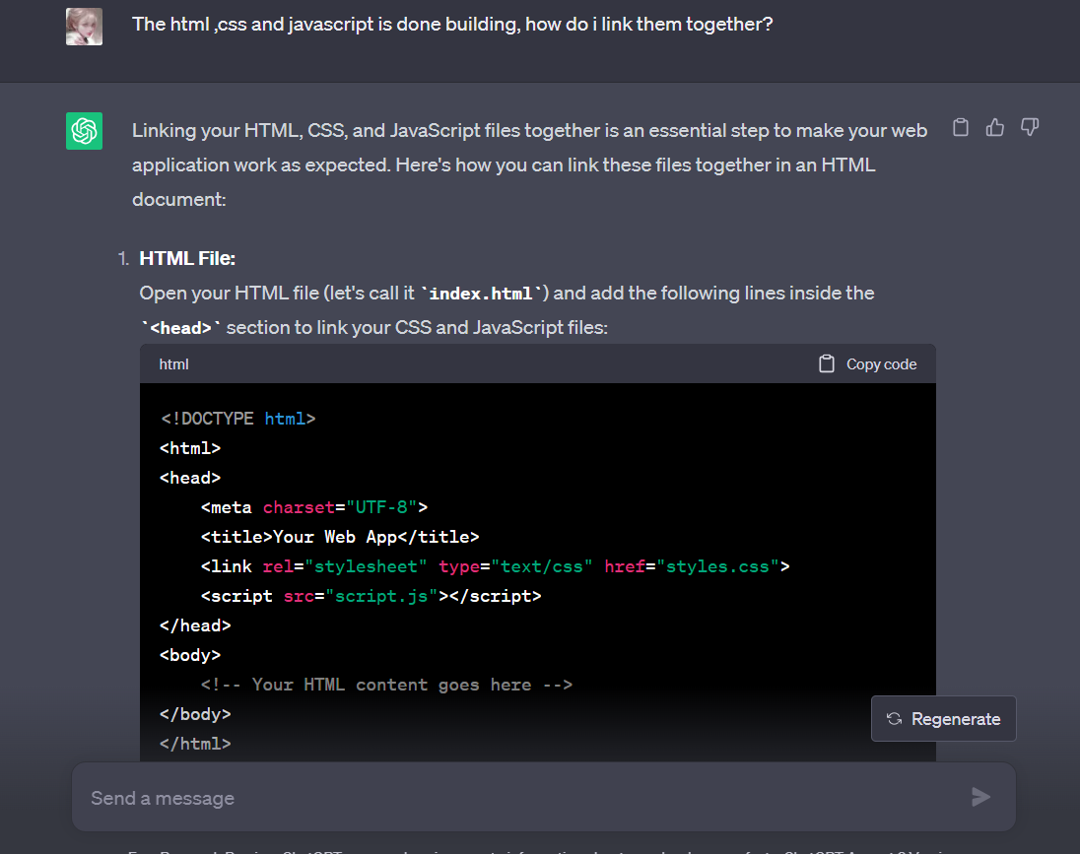
Error and Solving
Syntax Error
Unexisted File error
Minor Mistake of Spelling
Recheck
Ask Google
Seeking Help from Others
Use ChatGPT

Slide 17
08
Personal Development
CLB WEB 1

Slide 18
In this Chanllenge, we learn about…
HTML and CSS
Database
Error handling
We have learn how to structure our project using HTML and style it using CSS.
Forming a database and linked with html
Deal with errors gracefully.

Slide 19
Thanks for paying attention!
Present by: SUN YI NING, YEOH WAN QI, LIM XING YING
Please keep this slide for attribution

